Slide 1
Clustering Algorithms

Slide 2
List of Clustering Algorithms
1. Bisecting K-Means Clustering
2.BIRCH Clustering
3.Affinity Propagation Clustering
4.Mean Shift Clustering
5.DBSCAN Clustering
6.HDBSCAN Clustering
7.OPTICS Clustering
8.Spectral Clustering
9.KMeans Clustering
10.Agglomerative Clustering

Slide 3
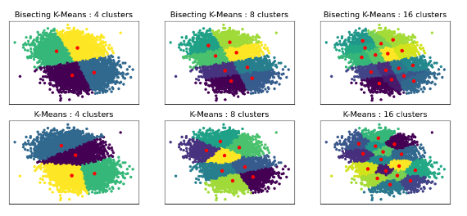
1. Bisecting K-Means Clustering
What is Bisecting K-Means Clustering?
Bisecting K-means is a hierarchical clustering method that builds a hierarchy of clusters by iteratively splitting them into smaller clusters. It combines aspects of K-means and hierarchical clustering.

Slide 4
How Bisecting KMeans Works?
Step 1: Start with all data in one cluster.
Step 2: Split the largest cluster using standard KMeans.
Step 3: Repeat until the desired number of clusters is achieved.
Step 4: Form a Hierarchical Structure
The result is a hierarchical tree-like structure

Slide 5
Example: Organizing a Large Conference
Scenario: Imagine you're organizing a large conference with numerous attendees from various industries. You want to group them into distinct categories based on their interests and roles, but you don’t know the exact number of groups you need.
Start with One Group: Begin by considering all attendees as one large group. This group includes everyone with various interests and roles.
First Split: Use K-means to split this large group into two smaller groups based on their interests and roles. For example, you might end up with one group of technology professionals and another group of marketing professionals.
Evaluate and Split Further:
Choose the larger or more diverse of the two groups for further splitting. Suppose the technology group is diverse, with subgroups like software developers and data scientists.
Apply K-means again to this technology group, splitting it into two subgroups, such as software developers and data scientists.
Repeat the Process: Continue this process iteratively. Each time, pick a group and split it into two based on its diversity or size until you achieve the desired number of clusters.
Final Groups: By the end of the process, you’ll have multiple distinct groups, such as:
Software Developers
Data Scientists
Marketing Specialists
Business Analysts

Slide 6
Bisecting KMeans – Pros & Cons
Advantages
Hierarchical Structure
understanding the data's structure at different levels of granularity
Efficiency
Improved Speed
Simplicity
Intuitive Process
Scalability
work well with larger datasets
Flexibility
Cluster Quality Control
Disadvantages
Initial Cluster Choice
Poor choices may lead to less meaningful clusters
K-means Limitations
Sensitivity to Initial Centroids
Fixed Splitting Method
Binary Splitting
Number of Clusters
might require additional validation or domain knowledge.
Cluster Quality Variability
Inconsistent Results

Slide 7
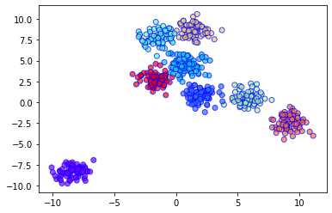
2.BIRCH Clustering
What is BIRCH Clustering?
Balanced Iterative Reducing and Clustering using Hierarchies.
can cluster large datasets by first generating a small and compact summary of the large dataset that retains as much information as possible.
This smaller summary is then clustered instead of clustering the larger dataset.
Designed for very large datasets and can handle noise and outliers.

Slide 8
How BIRCH Works
Build a Clustering Feature (CF) Tree to summarize data.
Apply clustering to leaf nodes to form clusters.
Optionally refine clusters with other clustering algorithms.

Slide 9
Example: Segmenting Customer Data for a Retail Store
Scenario: A retail store wants to segment its customer base to improve marketing. The store has a large dataset with purchase history, visit frequency, and spending patterns.
Initial Data Collection: Gather customer transaction data.
Build the CF Tree: BIRCH creates a CF tree to summarize clusters hierarchically, managing data efficiently.
Clustering Large Dataset: Start with broad clusters (e.g., “Frequent Shoppers” and “Occasional Shoppers”) and refine as more data comes in.
Refinement: Split broad categories into more specific sub-clusters (e.g., “High Spend” and “Medium Spend”).
Final Clusters:
High Spend Frequent Shoppers
Medium Spend Frequent Shoppers
High Spend Occasional Shoppers
Low Spend Occasional Shoppers
Targeted Marketing: Use these segments to create tailored marketing strategies, such as special offers for high spenders or loyalty rewards for frequent shoppers.

Slide 10
BIRCH Clustering – Pros & Cons
Advantages
Scales well with large datasets.
Handles noise and outliers effectively.
Disadvantages
only process metric attributes.
May not perform well on very high-dimensional data.

Slide 11
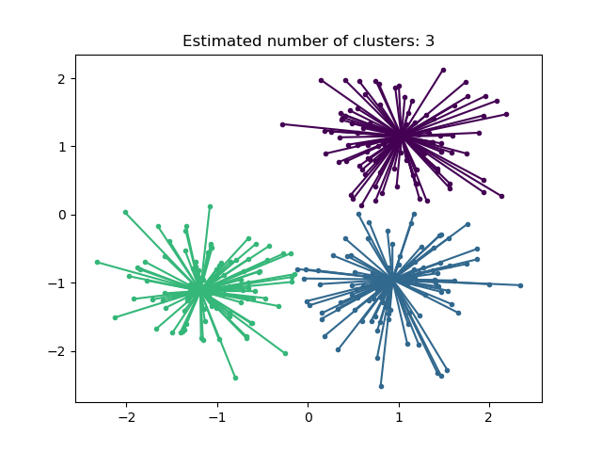
3.Affinity Propagation Clustering
What is Affinity Propagation Clustering?
Affinity: Measure of similarity between data points
Propagation: Spreading information between points
Clustering: Grouping similar data points together
Definition: An algorithm that group data into clusters without predefining the number of clusters.
Exemplars: Key data points (representative) that represents each clusters
Automatic: Determines the number of clusters on its own

Slide 12
How does Affinity Propagation Clustering work?
Exemplar
Similarity and Preferences
Message Passing
Iterative Updates and Convergence
Selection of Exemplars and Determination of Clusters

Slide 13
Example: Grouping Research Papers by Topic
Scenario: A university library wants to organize its large collection of research papers into meaningful groups based on their topics. Instead of specifying the number of topics in advance, they use Affinity Propagation Clustering.
Data Collection: Gather features from research papers, such as keywords, abstracts, and citations.
Calculate Similarities: Compute the similarity between all pairs of papers. For example, papers with similar keywords and topics are more closely related.
Cluster Formation: Affinity Propagation identifies “exemplars” (representative papers) and forms clusters around these exemplars. Papers that are similar to a particular exemplar are grouped together.
Resulting Clusters:
Machine Learning: Papers focusing on machine learning algorithms and techniques.
Data Science: Papers related to data analysis, big data, and statistical methods.
Computer Vision: Papers discussing image recognition and computer vision technologies.
Utilize Clusters: The library can now organize papers into topic-based sections, making it easier for researchers to find relevant literature.
This approach helps in discovering and organizing research topics without needing to know the number of topics beforehand.

Slide 14
Affinity Propagation – Pros & Cons
Advantages
1. No Need to Predefine Clusters
2. Handles Complex Data Structures
3. Flexibility with Preferences
4. Fast and Efficient
5. No Initial Guess Required
Disadvantages
1. Sensitivity to Preferences
2. High Memory Usage
3. Potentially Long Convergence Time
4. Lack of Global Optimization
5. Difficulty in Interpreting Results

Slide 15
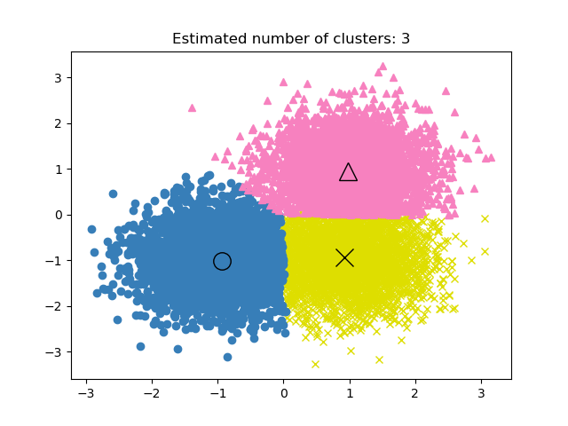
4.Mean Shift Clustering
What is Mean Shift Clustering?
It is a non-parametric algorithm, meaning it does not require prior knowledge of the number of clusters.
Identifies clusters by finding areas of high data point density
versatile and suitable for complex clustering tasks

Slide 16
How Mean Shift Clustering Works
Initialization:
Start with each data point as an initial cluster center.
Shifting:
For each cluster center, calculate the mean of data points within a defined radius (bandwidth). Shift the cluster center towards this mean.
Iteration:
Repeat the shifting process until cluster centers converge, meaning further shifts are minimal or none.
Cluster Formation:
Merge nearby cluster centers that are within the same density peak to form the final clusters.

Slide 17
Real-World Example
Imagine a city map with different food trucks scattered all over. You want to find out where the most popular food spots are, but you don't know how many popular spots there are.
Initialization: Start with each food truck as its own popular spot.
Finding Nearby Spots: For each food truck, see which other trucks are nearby within a certain walking distance (bandwidth).
Shifting Towards Popular Areas: Shift each spot towards the average position of the nearby trucks (where the crowd tends to gather).
Repeat: Keep shifting until the spots don't move much anymore.
Final Clusters: Merge nearby popular spots to identify major food truck hubs in the city.
This way, Mean Shift Clustering helps you automatically discover where the crowds are gathering, without needing to guess how many popular food spots there are.

Slide 18
Mean Shift Clustering – Pros & Cons
Advantages
No Need to Specify Number of Clusters:
Unlike K-means, it doesn't require the number of clusters as input.
Works Well with Arbitrary Shapes:
Can handle complex, non-linear cluster shapes.
Robust to Outliers:
Less sensitive to noise and outliers compared to K-means.
Disadvantages
Computationally Intensive:
It can be slow for large datasets due to its iterative nature and the need to calculate mean shifts for many points.
Choice of Bandwidth:
The results are highly dependent on the bandwidth parameter, which can be difficult to choose optimally.

Slide 19
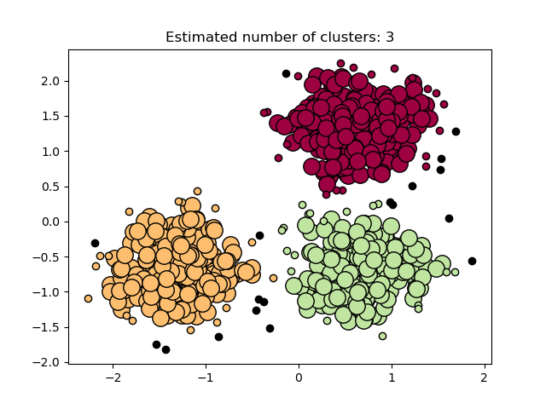
5.DBSCAN Clustering
What is DBSCAN Clustering?
DBSCAN (Density-Based Spatial Clustering of Applications with Noise)
A Clustering algorithm that groups data points based on their density, which means how closely packed the points are in a given area.
Do not explicitly calculate the number of clusters. Instead, the algorithm automatically finds clusters based on density (epsilon and min_samples parameters).
it works well even when clusters have irregular shapes or sizes.

Slide 20
Example: Finding groups of people at a party
Core Points: Imagine people who are standing close together in a tight group and talking. These people are the "core" of a group because they have other people nearby.
Border Points: Then there are people standing at the edge of the group, just listening or partially engaged. They are part of the group but not at its core.
Noise Points (Outliers): Finally, there might be a few people standing alone, far away from any group, perhaps waiting for a friend. These are considered "noise" or "outliers.“
DBSCAN helps you identify these groups (clusters) of people, even if they are of different shapes (circular, elongated, etc.), and ignores the people standing alone (noise).

Slide 21
How DBSCAN Works
Step1: Pick a Point: Start with any point in your data.
Step 2: Check Its Neighborhood: Look around this point within a certain distance (called epsilon). Count how many other points are within this distance.
Step3: Determine Point Type:
If there are enough points (say, ‘min_samples’), it is a Core Point and starts forming a cluster.
If there are not enough points, it's either a Border Point (close to another cluster) or Noise (an outlier).
Step 4: Expand the Cluster: For a Core Point, all points within the distance are added to the cluster. The algorithm repeats this for any new Core Points found nearby, expanding the cluster further.
Step5: Repeat Until Done: The algorithm moves on to the next unvisited point and repeats the process until all points are either clustered or marked as noise.

Slide 22
DBSCAN Clustering – Pros & Cons
Advantages
No Need to Know the Number of Clusters: Unlike some other methods, you don't need to decide how many groups (clusters) you expect upfront.
Works with Odd Shapes: It can find clusters of all kinds of shapes (not just circles or squares).
Handles Outliers Automatically: Points that don’t fit into any cluster are marked as noise, so you don’t have to worry about outliers.
Disadvantages
Parameter Sensitivity: You need to set epsilon (the distance to look for neighboring points) and min_samples (the minimum number of points needed to form a cluster). Setting these incorrectly can lead to poor results.
Different Densities: If your data has clusters with very different densities, DBSCAN might not work as well because a single epsilon value might not fit all clusters.

Slide 23
6.HDBSCAN Clustering
What is HDBSCAN Clustering?
Hierarchical Density-Based Spatial Clustering of Applications with Noise
An advanced clustering algorithm that extends DBSCAN. It can handle varying densities and is more robust in identifying clusters compared to DBSCAN
Key Features:
Hierarchical Clustering: HDBSCAN builds a hierarchy of clusters based on the density of data points, allowing it to handle clusters of varying shapes and sizes.
Density-Based: It groups data points that are closely packed together, and considers sparse regions as noise.
Noise Handling: Unlike traditional DBSCAN, HDBSCAN can better handle noise and outliers in the data.
Variable Density: It can find clusters of different densities, which is a limitation of DBSCAN.

Slide 24
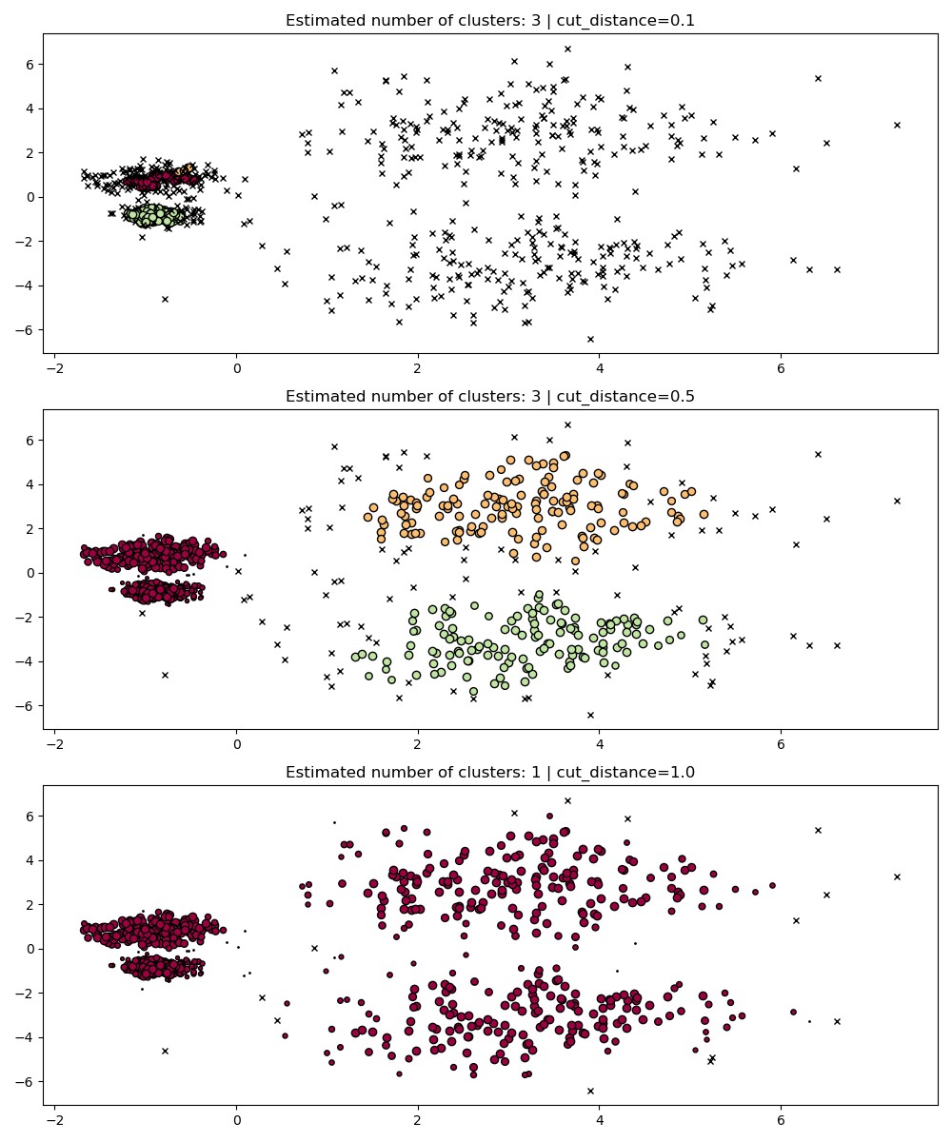

Slide 25
How HDBSCAN works:
Build a Hierarchical Tree: HDBSCAN starts by creating a hierarchy of clusters based on the density of points.
Condense the Tree: It then condenses the tree to find the most stable clusters, effectively removing less significant ones.
Extract Clusters: The final clusters are derived from the most stable parts of the hierarchy.

Slide 26
Example: Customer Segmentation
Scenario:
You have a dataset with customer spending and purchase frequency, and you want to group customers into segments so you can tailor your marketing efforts.
Identify Clusters:
HDBSCAN will analyze the data to find groups (clusters) of customers who have similar spending and purchasing habits.
For instance, it might find clusters of:
High spenders who purchase frequently.
Moderate spenders who purchase occasionally.
Low spenders who make few purchases.
Handle Noise:
Some customers might not fit neatly into any of the identified clusters. HDBSCAN will identify these as noise or outliers, meaning their purchasing behavior is too different from the clusters to be classified.
Varying Densities:
HDBSCAN can handle clusters of different shapes and sizes. For example, it can identify a dense group of high spenders even if they are not spread out evenly, and a less dense group of occasional buyers.

Slide 27
HDBSCAN Clustering – Pros & Cons
Advantages
Hierarchical Clustering
useful for understanding the relationships between different clusters at various levels of granularity
Robust to Noise and Outliers
No Need to Specify Number of Clusters
Scales Well with Large Datasets
Flexible Parameters
Handles Varying Densities
HDBSCAN can find clusters of different shapes and densities, unlike some algorithms that assume clusters are of similar density
Disadvantages
Not Always Suitable for Very Large Datasets
Requires Cython for Installation
May Struggle with Highly Variable Density
Memory and Computation Intensive
Especially during the hierarchical clustering phase.
Sensitivity to Parameters
Choosing inappropriate values can affect the quality of clustering.
Complexity
The hierarchical approach can be more complex to understand and interpret compared to simpler clustering algorithms like K-means.

Slide 28
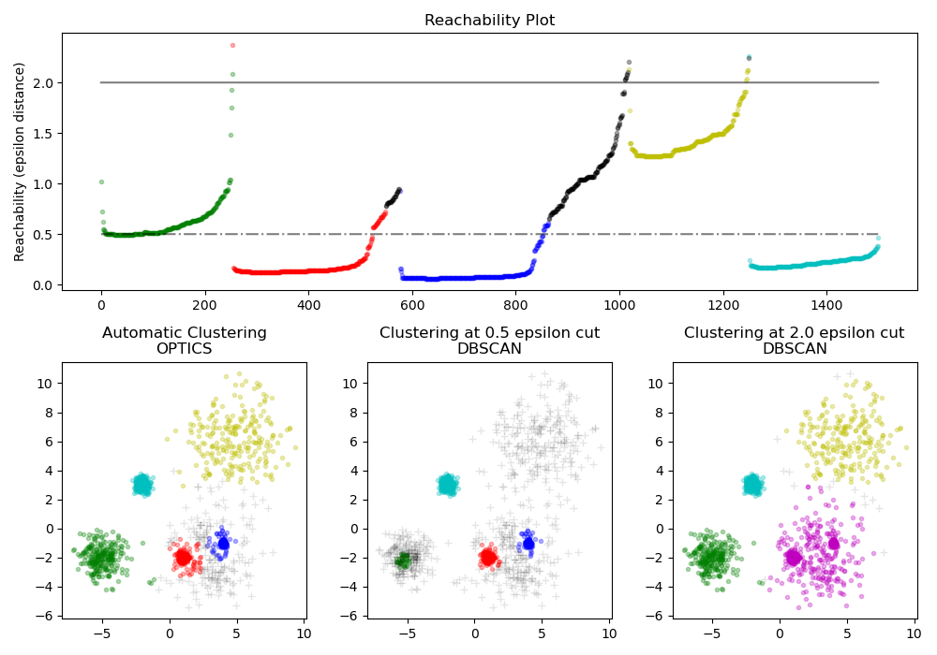
7.OPTICS Clustering
What is OPTICS Clustering?
OPTICS (Ordering Points To Identify the Clustering Structure)
A density-based clustering algorithm designed to identify clusters in data that vary in shape, size, and density.
It extends the DBSCAN algorithm by not requiring a fixed density threshold, making it more flexible for discovering clusters of varying densities.

Slide 29
How OPTICS Clustering Works
Identify Core Points
A point with enough close neighbors to form a dense area.
Compute Reachability Distances
The distance required to reach a point from another, considering density.
Order Points by Reachability
The sequence in which points are processed to reveal clusters.
Generate Reachability Plot

Slide 30
Real-World Example: Grouping Social Media Users
Imagine you have data on social media users based on their activity levels:
Features: Number of posts, likes, and comments per day.
Goal: Identify different groups of users, such as highly active users, moderately active users, and inactive users.
Applying OPTICS Clustering
Find Core Points: OPTICS identifies users who are central to dense groups (e.g., very active users who frequently post, like, and comment).
Calculate Reachability Distances: It calculates how "reachable" each user is from others based on their activity levels. Highly active users will have small reachability distances to other active users.
Order and Plot: The algorithm orders all users and generates a reachability plot. Clusters of similar users (like active and inactive) are represented by valleys, while isolated users (those who don’t fit into any group) form peaks in the plot.

Slide 31
OPTICS Clustering – Pros & Cons
Advantages
Identifies Clusters of Varying Densities
No Need to Specify Number of Clusters
Handles Noise Effectively
Produces Reachability Plot
More Robust Than DBSCAN
Disadvantages
Computational Complexity
Requires Parameter Tuning
Memory Consumption
less efficient for high-dimensional data.

Slide 32
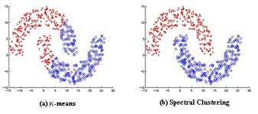
8.Spectral Clustering
Spectral Clustering is a variant of the clustering algorithm that uses the connectivity between the data points to form the clustering.
It uses eigenvalues and eigenvectors of the data matrix to forecast the data into lower dimensions space to cluster the data points.
It is based on the idea of a graph representation of data where the data point are represented as nodes and the similarity between the data points are represented by an edge.

Slide 33
Steps in Spectral Clustering
Create a Similarity Matrix
Compute a similarity matrix for the data points, usually using a Gaussian kernel or nearest neighbors.
Construct the Laplacian Matrix
Calculate the graph Laplacian from the similarity matrix
Compute Eigenvalues and Eigenvectors
Perform eigen decomposition on the Laplacian matrix to find its eigenvalues and eigenvectors.
Select Top Eigenvectors
Choose the top k eigenvectors corresponding to the smallest k eigenvalues.
Cluster in Reduced Space
Use K-means or another clustering algorithm on the new feature space formed by these eigenvectors.

Slide 34
Spectral Clustering
Problem: Grouping customers based on their purchasing behavior in an e-commerce platform.
Challenge: Customers may have complex purchasing patterns that don't form simple clusters (e.g., some buy seasonal items, others mix low-cost daily essentials with high-cost electronics).
Solution:
Step 1: Create a similarity matrix using customer purchase data, where each entry represents the similarity between two customers based on their purchase behavior.
Step 2: Construct a graph representation of the data, where nodes represent customers, and edges represent the similarity between them.
Step 3: Apply Spectral Clustering to partition the graph into clusters, grouping customers with similar purchasing patterns.
Step 4: Use the clusters to tailor marketing strategies, such as personalized recommendations, targeted promotions, and customer segmentation.
Outcome:
Targeted Marketing: Identifying distinct customer segments allows the company to send personalized offers, improving conversion rates.
Inventory Management: Understanding customer segments helps optimize inventory by forecasting demand for different product categories.
Enhanced Customer Experience: Grouping customers with similar behavior leads to better recommendations, increasing customer satisfaction and loyalty.

Slide 35
Spectral Clustering – Pros & Cons
Advantages
Flexible Cluster Shapes
Effective for Small and Medium-Sized Datasets
Less Sensitive to Initialization
Handles Complex Relationships
Useful for Clustering Graph Data
Disadvantages
Scalability Issues
Requires Choosing Parameters
Determining the Number of Clusters
Memory Intensive

Slide 36
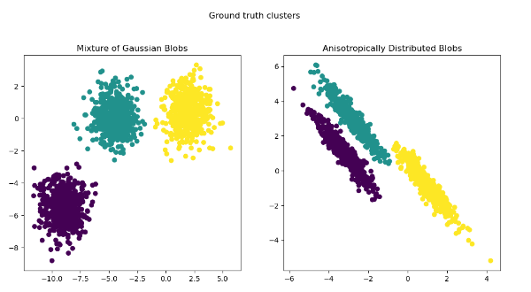
9.K-Means Clustering
K-Means Clustering is one of the most popular and straightforward clustering algorithms in machine learning. It aims to partition a dataset into K clusters, where each data point belongs to the cluster with the nearest mean (centroid).
Centroids: The center point of a cluster.
Distance Metric: Usually, the Euclidean distance is used to determine the closest centroid.
Inertia: The sum of squared distances of samples to their closest cluster center. Lower inertia means better clustering.

Slide 37
How K-Means Clustering Works
Initialize Centroids: Choose K initial centroids randomly from the dataset.
Assign Clusters: Assign each data point to the closest centroid based on the Euclidean distance.
Update Centroids: Calculate the mean of all data points in each cluster and update the centroid to this new mean.
Repeat: Repeat steps 2 and 3 until the centroids no longer change or a predefined number of iterations is reached.

Slide 38
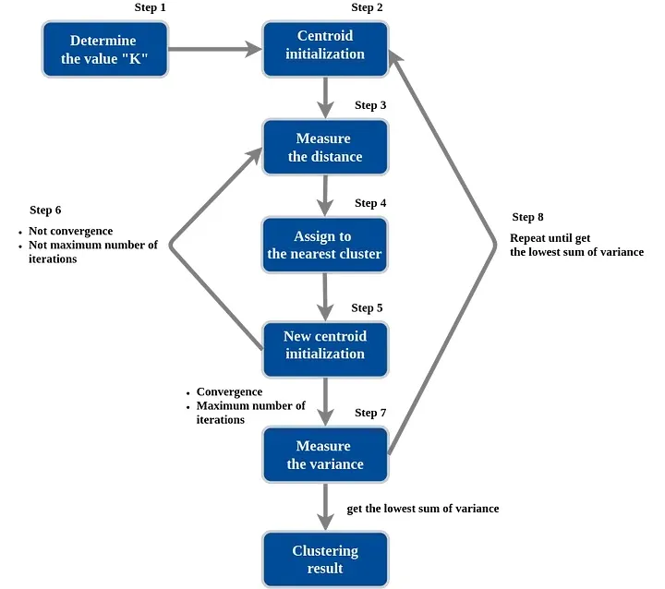

Slide 39
KMeans Clustering – Pros & Cons
Advantages
Simplicity and Efficiency: Easy to implement and computationally efficient, especially for large datasets.
Scalability: Scales well to a large number of samples and features.
Fast Convergence: Typically converges quickly to a solution, especially with a good initialization (e.g., K-Means++).
Interpretability: Provides clear and intuitive cluster assignments that are easy to understand and interpret.
Disadvantages
Requires Pre-Defined K: The number of clusters (K) must be specified beforehand, which can be challenging if the optimal K is unknown.
Sensitive to Initialization: Results can vary significantly based on the initial placement of centroids; poor initialization may lead to suboptimal clustering.
Assumes Spherical Clusters: Assumes clusters are roughly spherical and equally sized, which might not be true in all datasets.
Sensitive to Outliers:
Not Suitable for Non-Linear Data

Slide 40
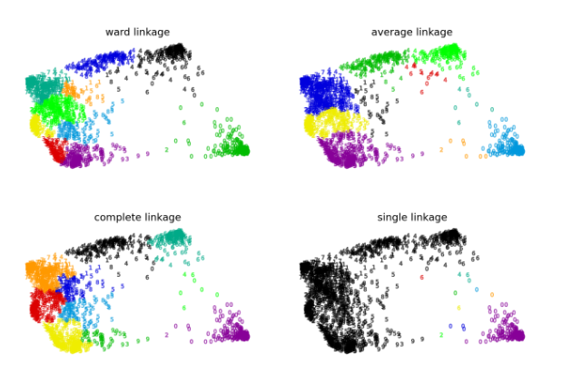
10.Agglomerative Clustering
Agglomerative Clustering is a type of hierarchical clustering that builds clusters by merging smaller clusters iteratively.
It is a “bottom-up” approach, meaning that it starts with each data point as its own cluster and gradually merges them based on their similarity until all data points are grouped into a single cluster.

Slide 41
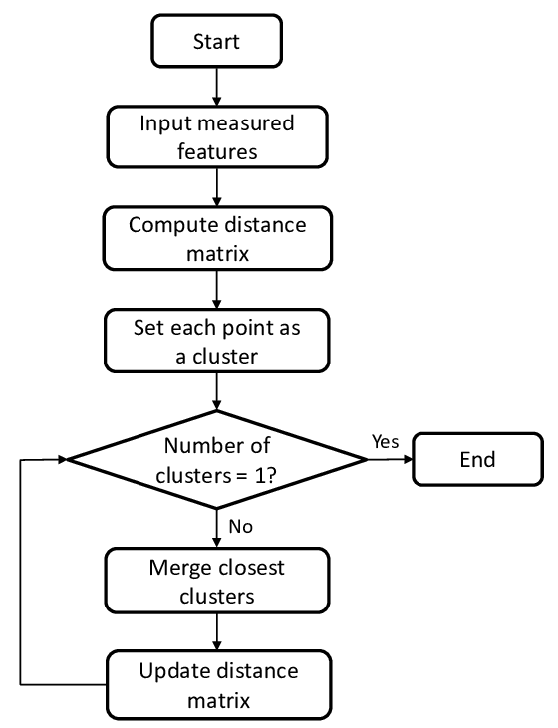
How Agglomerative
Works

Slide 42
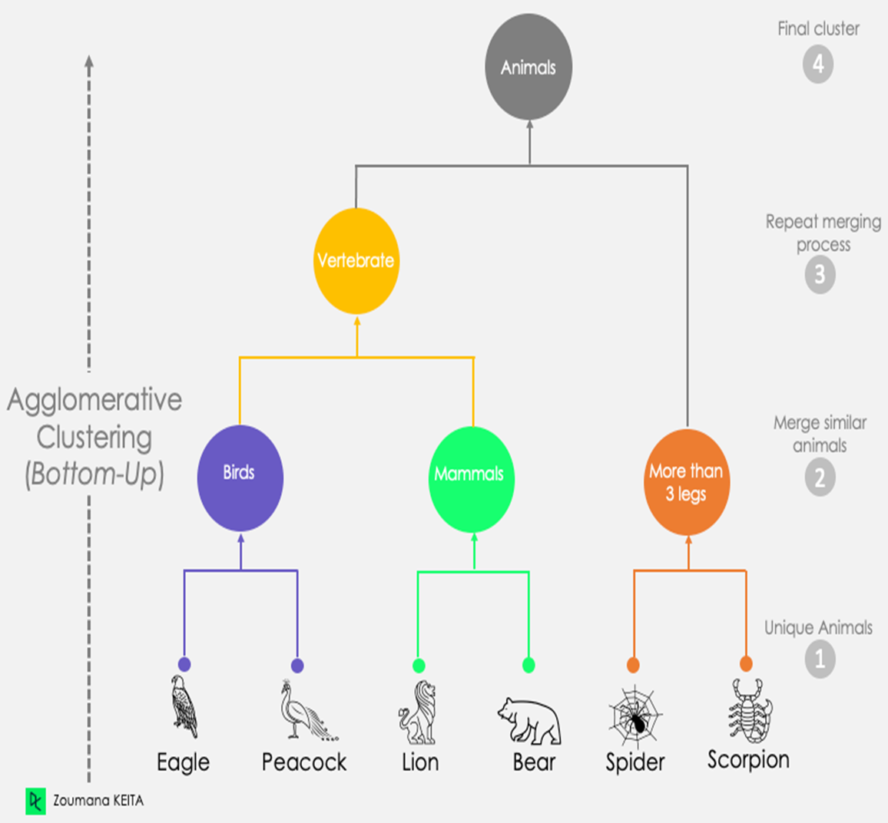
Real-World Example

Slide 43
Agglomerative Clustering – Pros & Cons
Advantages
Simple to Understand: The algorithm is easy to understand and implement.
Hierarchical Structure: Produces a dendrogram, which shows the hierarchical relationship between clusters.
Flexible Linkage Criteria: Different linkage methods (single, complete, average, Ward’s) allow flexibility in defining cluster proximity.
Disadvantages
Computationally Intensive: Especially for large datasets, as it requires computing and updating the distance matrix repeatedly.
Sensitive to Noise: Outliers can affect the clustering results, especially with certain linkage methods.
No Fixed Number of Clusters: Unlike K-Means, it does not require specifying the number of clusters in advance, but selecting the appropriate number of clusters from the dendrogram can be subjective.

